Slide 1



PC2: Pseudo-Classification Based Pseudo-Captioning for
Noisy Correspondence Learning in Cross-Modal Retrieval
Yue Duan¹², Zhangxuan Gu², Zhenzhe Ying², Lei Qi³ , Changhua Meng², and Yinghuan Shi¹
¹ Nanjing University, China ² Ant Group, China ³ Southeast University, China
arXiv：https://arxiv.org/pdf/2408.01349
GitHub：https://github.com/alipay/PC2-NoiseofWeb
HuggingFace: https://huggingface.co/datasets/NJUyued/NoW
Zhihu（知乎）: https://zhuanlan.zhihu.com/p/711149124
Notes:
Today we present the papers accepted by ACMMM2024: PC2: Pseudo-Classification Based Pseudo-Captioning for
Noisy Correspondence Learning in Cross-Modal Retrieval

Slide 2



PC2: Pseudo-Classification Based Pseudo-Captioning for Noisy Correspondence Learning in Cross-Modal Retrieval
Cross-Modal Retrieval
soccer player is beaten to the ball by the soccer player
Image
Encoder
Similarity
Measurement
Text
Encoder
Notes:
We mainly focus on the cross-modal retrieval task, which can be defined as retrieving the corresponding text and image using an image or text as a query, respectively.

Slide 3
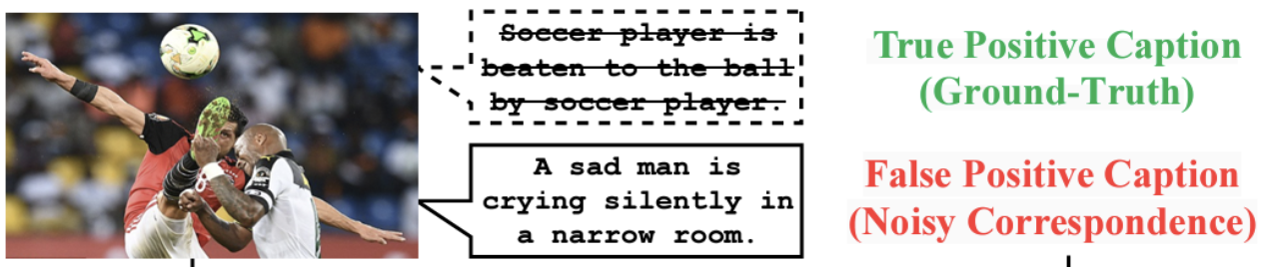

PC2: Pseudo-Classification Based Pseudo-Captioning for Noisy Correspondence Learning in Cross-Modal Retrieval
Introduction
Current cross-modal retrieval models rely on training on precisely matched data pairs
Manually annotating images and text is time-consuming and laborious,
while automatically collected data has noisy correspondence
Training robust cross-modal retrieval models in the presence of noisy correspondence
Notes:
Current cross-modal retrieval models rely on training on precisely matched data pairs, and Manually annotating images and text is time-consuming and laborious,
while automatically collected data has noisy correspondence.This refers to the semantic mismatch between the image and the caption. Thus, we need to train

Slide 4

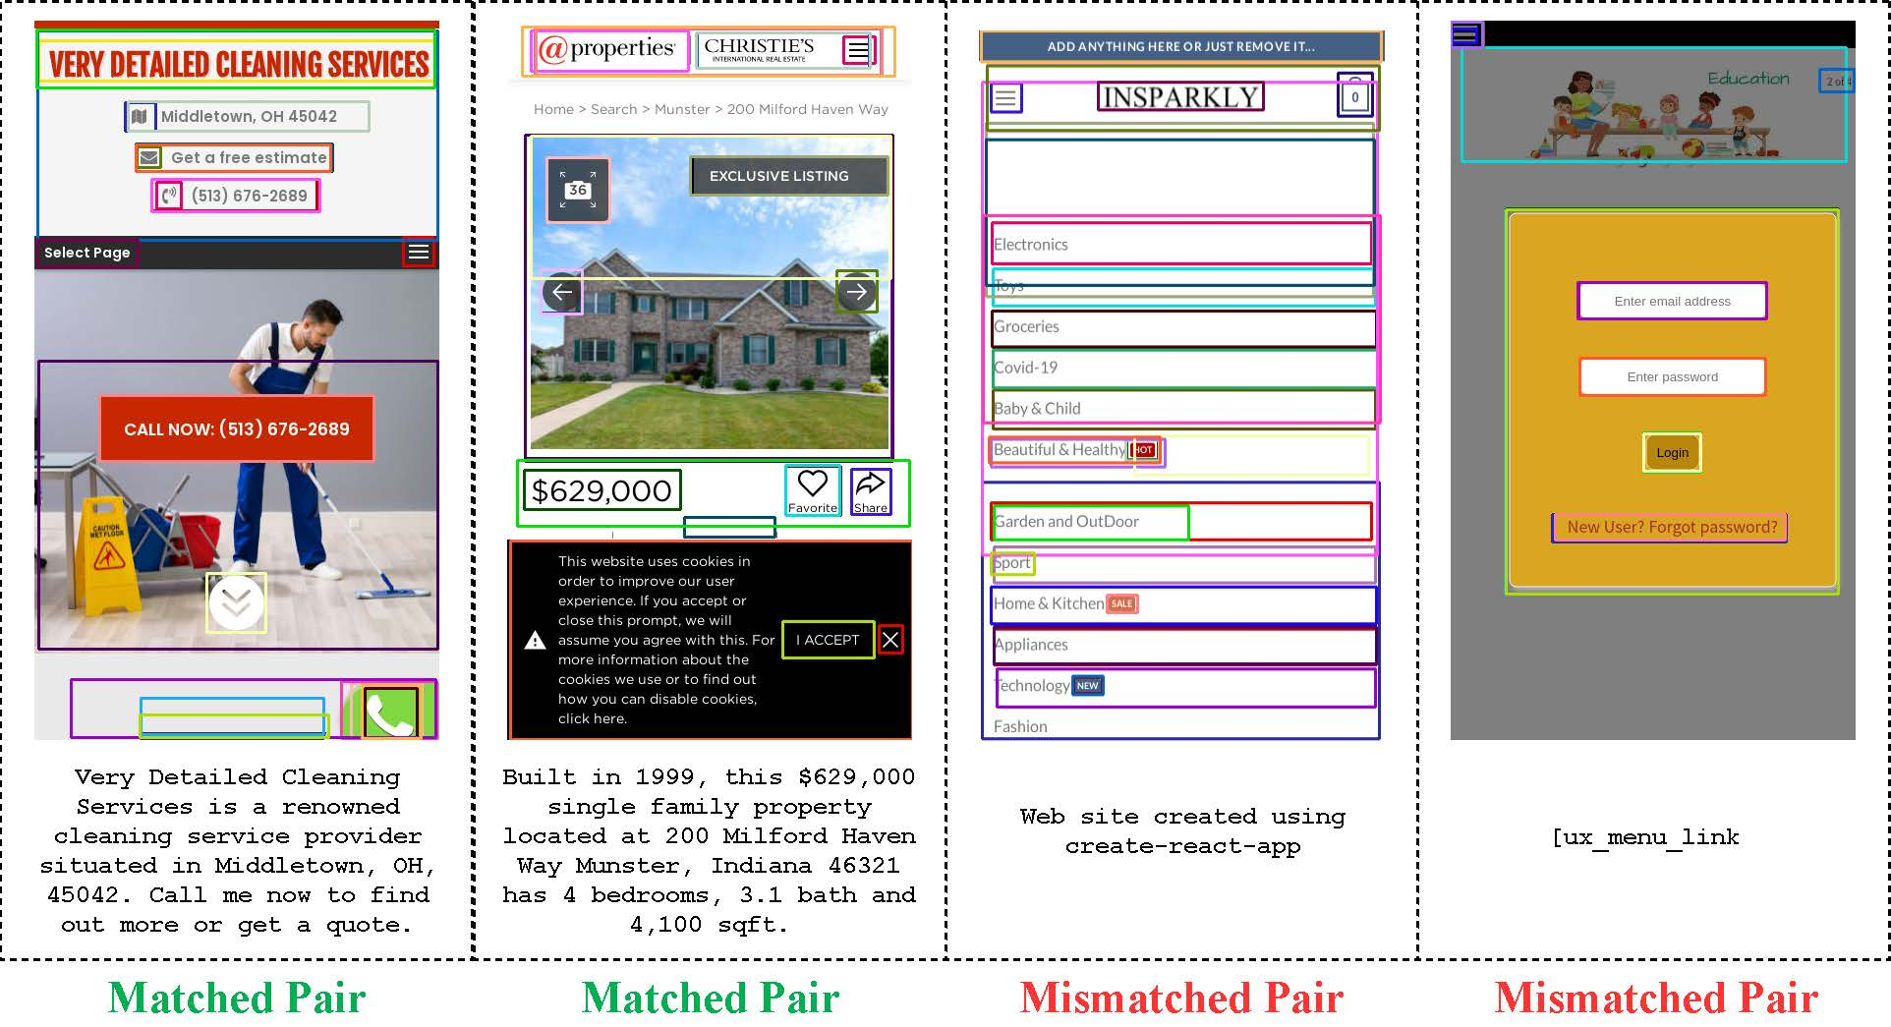
PC2: Pseudo-Classification Based Pseudo-Captioning for Noisy Correspondence Learning in Cross-Modal Retrieval
Dataset Contribution – Noise of Web (NoW)
Previous NCL research was mainly based on artificially simulated datasets for evaluation
We propose an NCL dataset collected in a real industry environment
The dataset contains 100,000 [webpage screenshot (image)-meta description (text)] data pairs extracted directly from the web page
98,000 pairs are used for training, 1,000 pairs are used for validation, and 1,000 pairs are used for testing
Notes:
In this paper we have a dataset contribution. Specifically, since Previous NCL research was mainly based on artificially simulated datasets for evaluation ， We propose an NCL dataset collected in a real industry environment， which is called NoW.
The dataset contains 100,000 [webpage screenshot (image)-meta description (text)] data pairs extracted directly from the web page

Slide 5


PC2: Pseudo-Classification Based Pseudo-Captioning for Noisy Correspondence Learning in Cross-Modal Retrieval
Dataset Contribution – Noise of Web (NoW)
Previous NCL research was mainly based on artificially simulated datasets for evaluation
We propose an NCL dataset collected in a real industry environment
The dataset contains 100,000 [webpage screenshot (image)-meta description (text)] data pairs extracted directly from the web page environment
98,000 pairs are used for training, 1,000 pairs are used for validation, and 1,000 pairs are used for testing
Notes:
Here are some examples

Slide 6

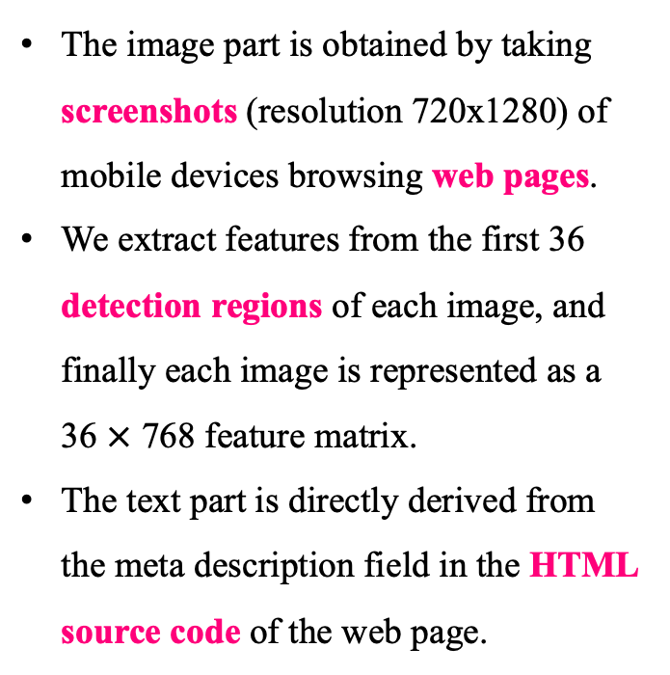
PC2: Pseudo-Classification Based Pseudo-Captioning for Noisy Correspondence Learning in Cross-Modal Retrieval
Dataset Contribution - Noise of Web (NoW)
The image part is obtained by taking screenshots (resolution 720x1280) of mobile devices browsing web pages.
We extract features from the first 36 detection regions of each image, and finally each image is represented as a 36 $×$ 768 feature matrix.
The text part is directly derived from the meta description field in the HTML source code of the web page.
The noise ratio of NoW is close to 70%
Notes:
The image part is obtained by taking screenshots and The text part is directly derived from the meta description field in the HTML source code. The noise ratio of NoW is close to 70%

Slide 7

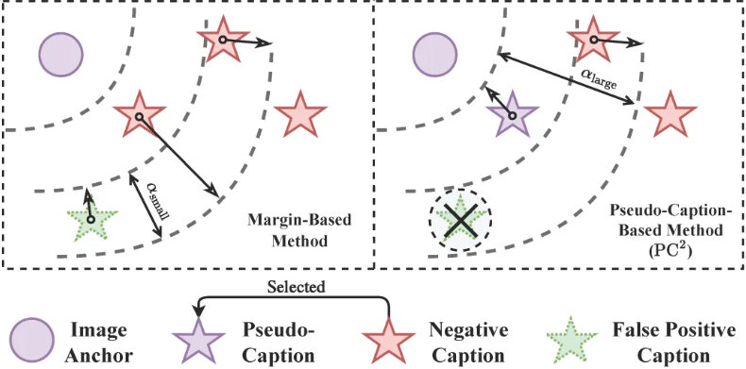
PC2: Pseudo-Classification Based Pseudo-Captioning for Noisy Correspondence Learning in Cross-Modal Retrieval
Motivation
Previous NCL solutions mostly adopt the soft margin based triplet ranking loss to mitigate the negative impact of mismatched data on the training process
They fail to directly provide beneficial supervision signals for false positive data pairs, but only weaken the negative effects of false supervision
Notes:
Previous NCL solutions mostly adopt the soft margin based triplet ranking loss to mitigate the negative impact of mismatched data on the training process，They fail to directly provide beneficial supervision signals for false positive data pairs, but only weaken the negative effects of false supervision

Slide 8
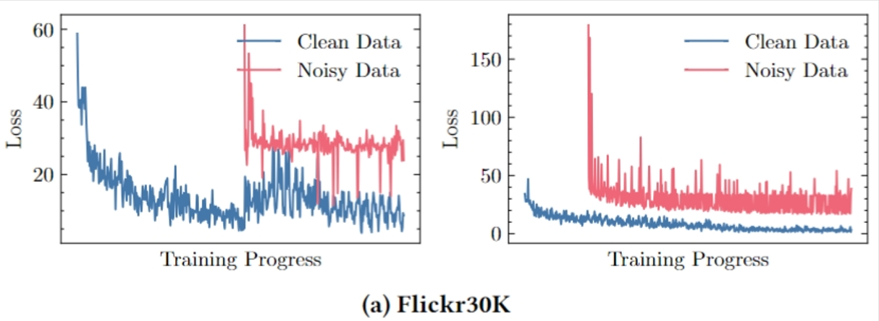

PC2: Pseudo-Classification Based Pseudo-Captioning for Noisy Correspondence Learning in Cross-Modal Retrieval
Motivation
Even though these methods strive to resist noise interference, their training process is still significantly affected by noisy data, resulting in drastic fluctuations in the loss curve
We should strengthen the learning of clean data from different perspectives
Notes:
Even though these methods strive to resist noise interference, their training process is still significantly affected by noisy data, resulting in drastic fluctuations in the loss curve

Slide 9

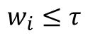
PC2: Pseudo-Classification Based Pseudo-Captioning for Noisy Correspondence Learning in Cross-Modal Retrieval
Overview
We propose Pseudo-Classification Based Pseudo-Captioning
Aims to provide effective supervision for all noisy data in cross-modal retrieval model training
Memorization Effect Based Data Division
soccer player is beaten to the ball by the soccer player
$$w_{i}≤τ$$
Two
Component
GMM
Noisy
Data
Clean
Data
Notes:
We propose Pseudo-Classification Based Pseudo-Captioning
Aims to provide effective supervision for all noisy data in cross-modal retrieval model training

Slide 10
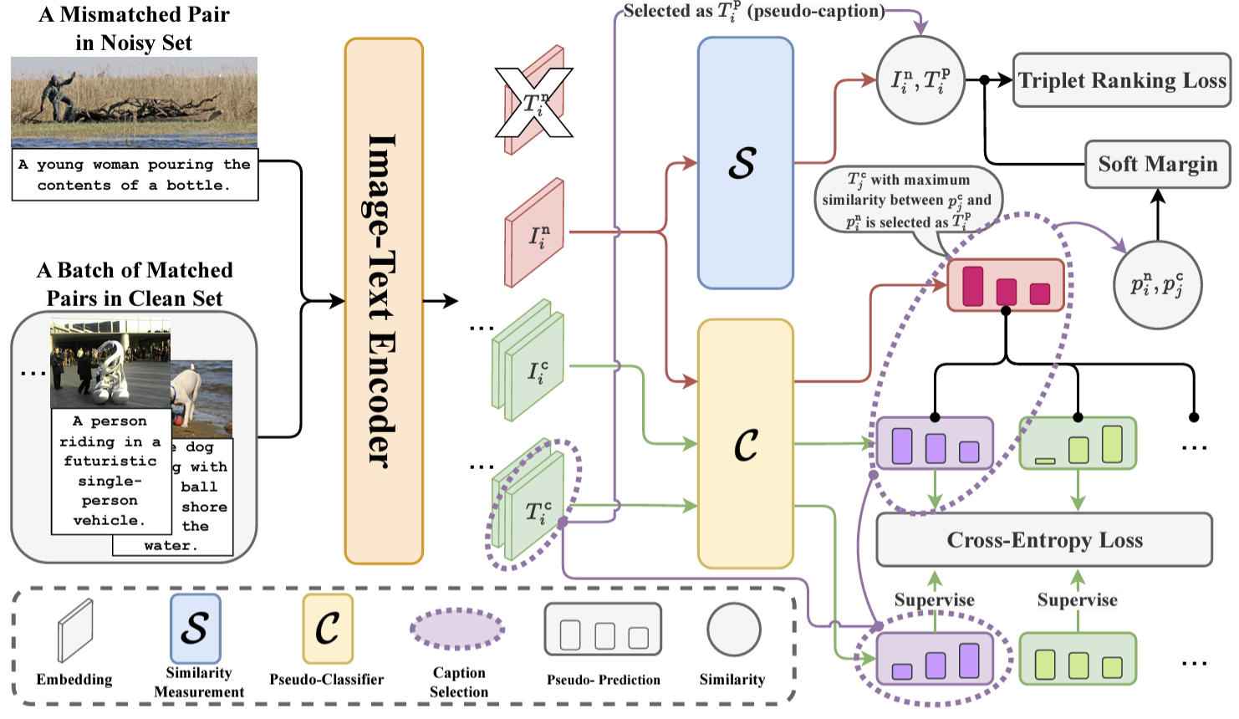

PC2: Pseudo-Classification Based Pseudo-Captioning for Noisy Correspondence Learning in Cross-Modal Retrieval
Method: PC2
Our method can be understood as an integrated solution consisting of the following three modules:
Pseudo-classification
Pseudo-classification based pseudo-captioning
Prediction Oscillation Based Correspondence Rectification

Slide 11
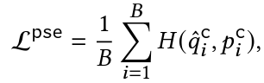
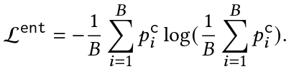

PC2: Pseudo-Classification Based Pseudo-Captioning for Noisy Correspondence Learning in Cross-Modal Retrieval
Method: Pseudo-Classification
Pseudo-Classification: Use pseudo classifiers to group visual semantic clusters into K pseudo-classes with images as anchors
Purpose: Strengthen modality alignment in a non-contrastive learning manner
Cross-entropy loss
Entropy loss
Visual semantics are grouped and learned by clusters according to K

Slide 12
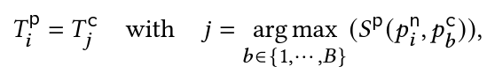
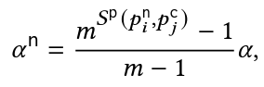
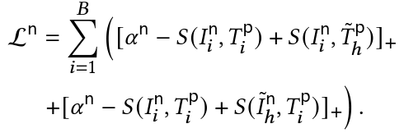

PC2: Pseudo-Classification Based Pseudo-Captioning for Noisy Correspondence Learning in Cross-Modal Retrieval
Method: Pseudo-Captioning
Pseudo-Captioning: Use the pseudo-classifier to assign pseudo-captions based on the similarity of the pseudo predictions of clean images and noisy images.
Purpose: Provide correct supervision for noisy images.
The caption of the clean image with the most similar pseudo-prediction is assigned as the pseudo-caption of the corresponding noisy image

Slide 13
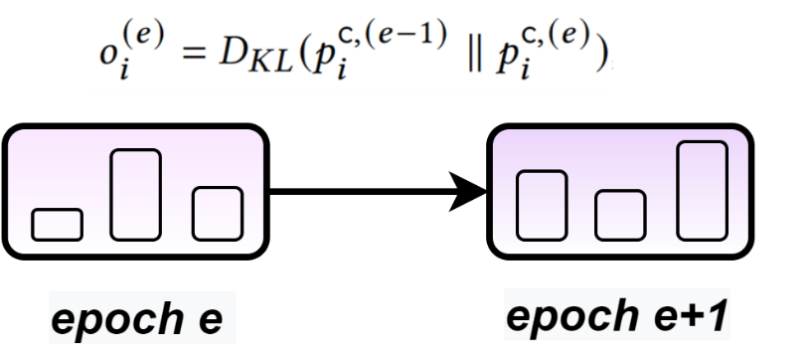
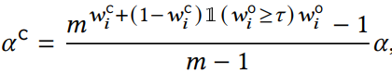
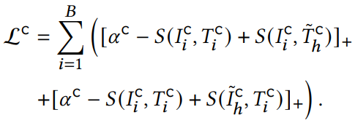

PC2: Pseudo-Classification Based Pseudo-Captioning for Noisy Correspondence Learning in Cross-Modal Retrieval
Method: Prediction Oscillation Based Correspondence Rectification
The pseudo-predictions output by the model based on the knowledge learned from pseudo-labels with correct correspondence should be stable
That is, the oscillating pseudo-predictions indicate low correspondence in the [image, pseudo-caption] pairs
output clean probability
with fitted GMM

Slide 14
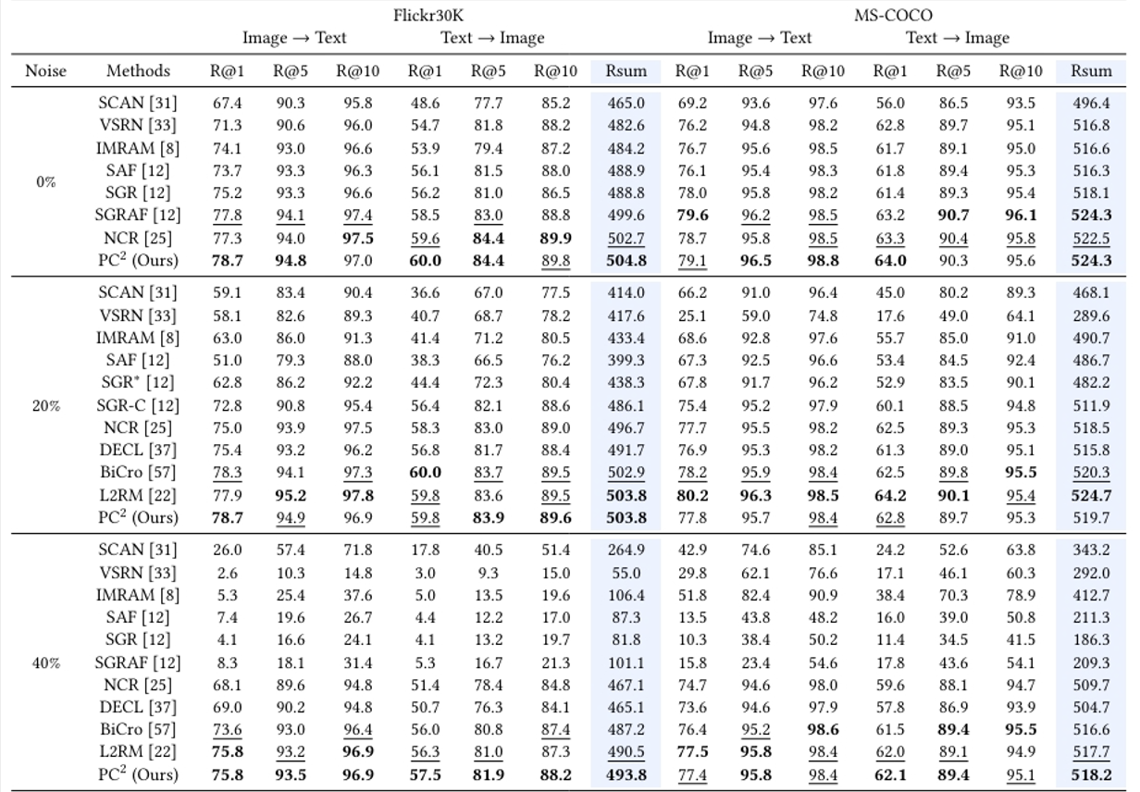
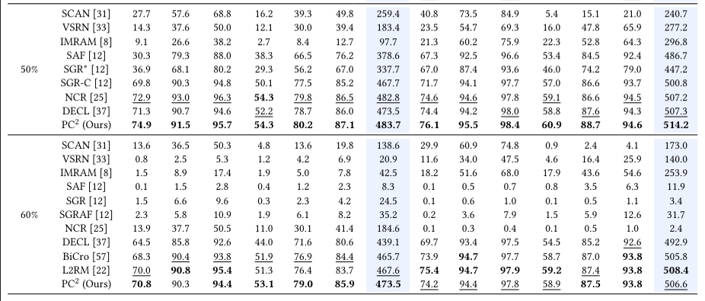

PC2: Pseudo-Classification Based Pseudo-Captioning for Noisy Correspondence Learning in Cross-Modal Retrieval
Experiment - Flickr30K, MS-COCO
Performance comparison of recall R@1, R@5, R10 and Rsum on Flickr30K and MS-COCO
Notes:
Our experiments on artificially simulated datasets and NoW demonstrate the superiority of our method.

Slide 15

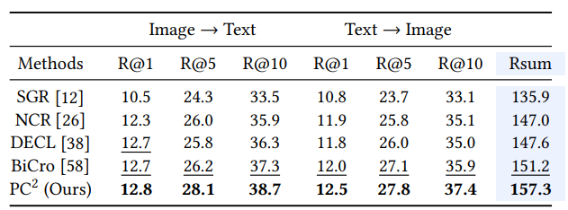
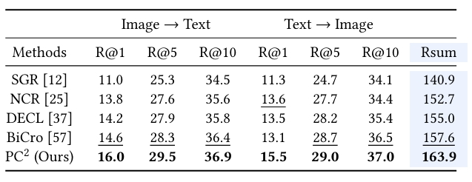
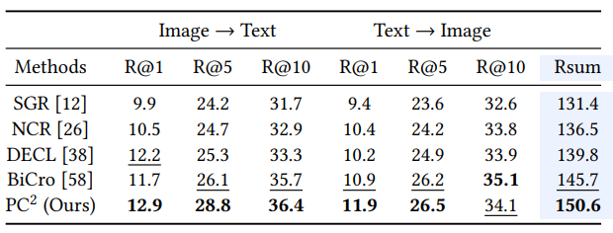
PC2: Pseudo-Classification Based Pseudo-Captioning for Noisy Correspondence Learning in Cross-Modal Retrieval
Experiment - NoW
Performance comparison of recall R@1, R@5, R10 and Rsum on NoW
Considering that although NoW is a multilingual dataset, including Chinese, English, Japanese, Russian, etc., but Chinese is the main part, we first use Jieba tokenizer to tokenize the text. We also provide data versions using BPETokenizer and pre-trained BertTokenizer for tokenization.
BPETokenizer
BertTokenizer
Jieba

Slide 16





Thanks!
arXiv：https://arxiv.org/pdf/2408.01349
GitHub：https://github.com/alipay/PC2-NoiseofWeb
HuggingFace: https://huggingface.co/datasets/NJUyued/NoW
Zhihu（知乎）: https://zhuanlan.zhihu.com/p/711149124
Notes:
Thank you for watching. We have provided links and QR codes for all resources related to the paper.

